Slide 1
Charles Horton Cooley
Dr. Syed Mehdi Abbas Zaidi
Department of Sociology
Shia PG College, Lucknow

Slide 2
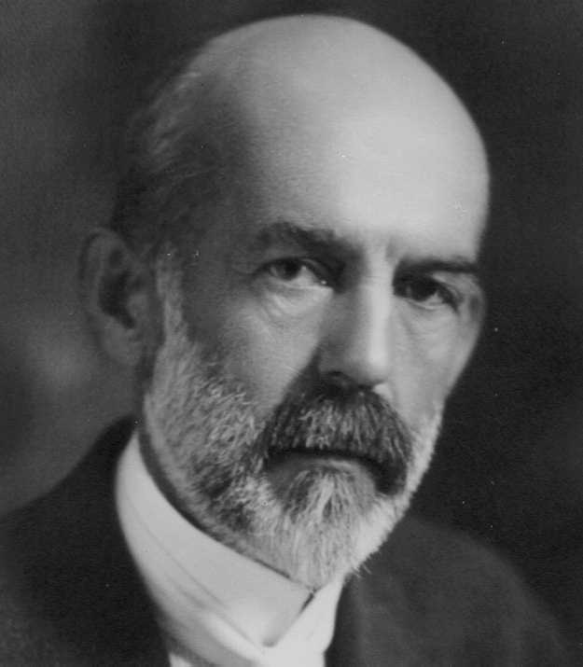
Charles Horton Cooley (August 17, 1864 – May 7, 1929)
American Sociologist, mainly associated with the University of Michigan where he studied and taught Economics and Sociology.
He was the founding member of the American Sociological Association in 1905.
Best known for his concept of “looking-glass self”.

Slide 3
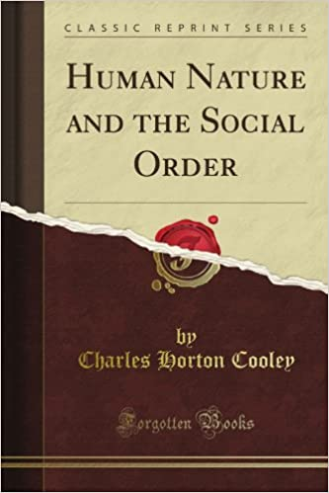
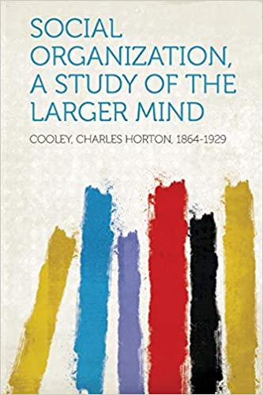
Cooley’s Major Works

Slide 4
Some of Cooley’s Works
1897: Genius, Fame and the Comparison of Races
1897: The Process of Social Change
1902: Human Nature and the Social Order
1907: Social Consciousness
1908: A Study of the Early Use of Self-Words by a Child
1909: Social Organization: a Study of the Larger Mind
1917: Social Control in International Relations
1929: The Life-Study Method as Applied to Rural Social Research
1930: Sociological Theory and Social Research, New York: Henry Holt

Slide 5
Looking Glass Self
The Looking-glass self is a social psychological concept, fashioned by Charles Horton Cooley in 1932.
This concept of the “looking glass-self” is without a doubt is his most renowned, and is known and accepted by most psychologists and sociologists today.
The term “looking glass self” was first used by Cooley in his work, Human Nature and the Social Order in 1902.

Slide 6
Steps of Looking Glass Self
As per C.H. Cooley (1902), in his work Human Nature and the Social Order, his “Looking-Glass Self” involves three steps:
Self imagination of how you appear to the other person.
Imagination of the judgment of the other person.
You feel some sense of happiness, pride, guilt, or of shame.

Slide 7
Concept of Self
The self is the subject of one’s own experience of phenomena: perception, emotions, thoughts, etc.
Definition of one’s identity, character, abilities, and attitudes, especially in relation to persons of things out side itself or oneself.

Slide 8
Example of Self
The real Alice, known only to her maker.
Her idea of herself
“I [Alice] look well in this hat”
Her idea of Angela’s idea of her
“Angela thinks I look well in this hat”
Her Idea of what Angela thinks she thinks of herself
“Angela thinks I am proud of my looks in this hat”
Angela’s idea of what Alice thinks of herself
“Alice thinks she looks stunning in that hat”

Slide 9
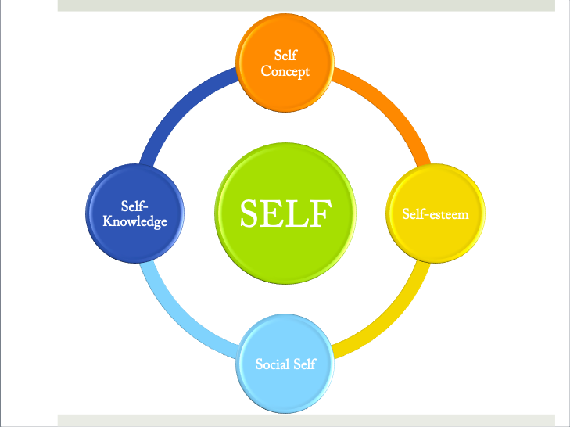

Slide 10
Self Concept
Self concept, self-construction, self-identity or self-perspective is a collection of beliefs about oneself.
It includes elements such a academic performance, gender roles an racial identity.
Generally, the concept of self contains the answer to the question Who am I?

Slide 11
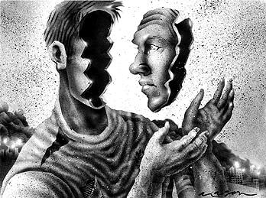
Self Knowledge
Philosophically, Self-knowledge commonly refers to the knowledge of one’s particular mental state that include one’s beliefs and desires.
Self- knowledge is a term that we use to describe the information that an individual draws upon when finding an answer to the question “What am I like?”

Slide 12
Self Esteem
Self esteem refers to having esteem in one’s own self (It includes having self confidence and the feeling of good about oneself.)
In simple terms, a confidence and satisfaction in oneself.

Slide 13
Social Self
Social Self is a part of self that engages face to face, in relation to others.
Social self can include gender, place of residence, age, or any other categorization that helps to characterize a person identity.

Slide 14
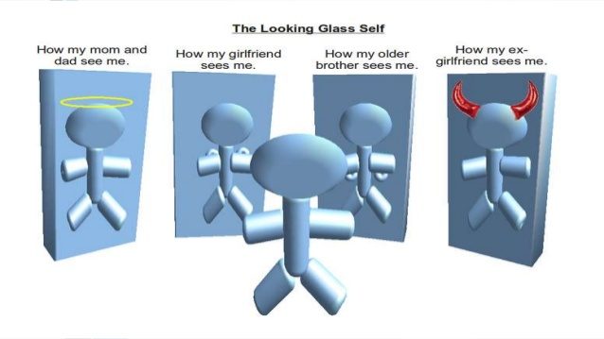

Slide 15
Concept of Society
Society is an interweaving and interworking of mental selves.
He imagine your mind and especially what your mind thinks about his mind.
He dress his mind before yours and expect that you will dress yours before his.
Whoever cannot or will not perform these feats is not properly in the game.

Slide 16
Concept of Primary Group
Emphasis on the wholeness of social life led Cooley to focus his analysis on those human groupings that he conceived to be primary in linking man with his society.
By primary group he mean those characterized by intimate face-to-face cooperation and association.
However, he himself never used the term secondary group. In this concept men may be related to one another through formal relationships.

Slide 17
Thank You

Slide 18
Reference Books
Sociological Theory and Social Research, Cooley, Charles Horton, Kelley (Augustus M.), Publishers, US
Cooley Charles Horton: Imagining Social Reality, Glenn Jacobs, University of Massachusetts Press
Looking Glass Self, Charles Horton Cooley, Daniel Sharp Editor, Wall Flower Books
Updating Charles H. Cooley Contemporary Perspectives on a sociological Classic, Edited by Natalia Ruiz- Junco and Baptize Brossard, Publisher- Rout ledge

